Slide 1


SEPM Project Car Racing Game: Track-Surf
By
Group 1
(Alex George Lain, Antonios Kalaitzakis, Kieron Holmes, Kikelomo Obayemi, Sergio Zavarce, Suresh Melvin Sigera, Victor Hernandez)
Software Engineering Project Management(SEPM) Module, UoEO

Slide 2
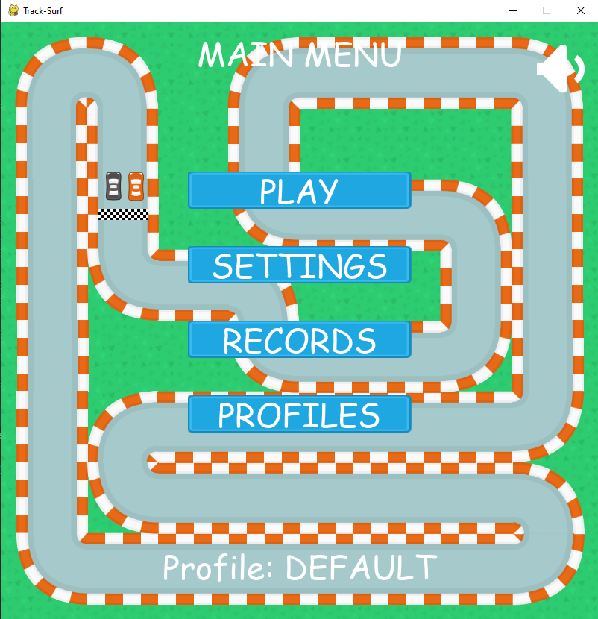
Project Overview
Track-Surf is a simple car racing game built for our client, Group 2, a children’s toy manufacturing company.
It is being developed to satisfy a list of 10 requirements provided by Group 2
Fig 1 shows a screenshot of track surf’s landing page. Six (6) out of the agreed 10 requirements have been fully implemented at this stage.
Fig 1: Track-Surf Landing Page

Slide 3
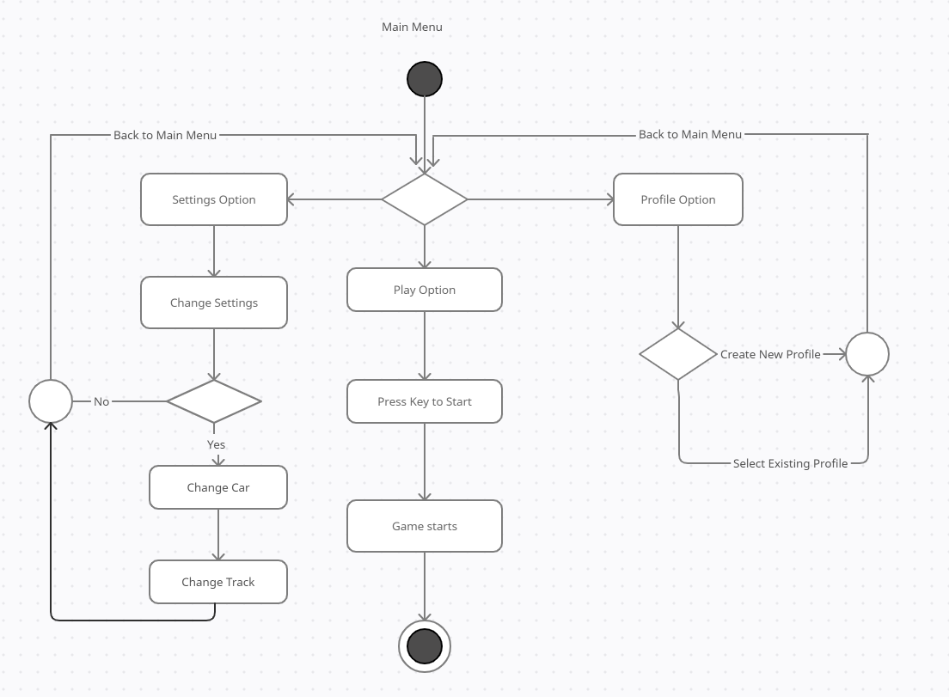
Game Design
Fig 2 is a simple activity diagram showing how track-surf is implemented
From the main menu, a user can select either of the settings, profile or play option and follow the steps as depicted in the diagram.
Fig 2: Track-Surf Activity Diagram (adapted from Siva Karthik Reddy et al., 2019)

Slide 4
Project Plan
After the completion of the requirements gathering phase, the subsequent phases were divided into 23 high level tasks, grouped into 7 sprints.
Planning tasks (Sprint 0) | Sprint 1 | Sprint 2 | Sprint 3 | Sprint 4 | Sprint 5 | Sprint 6
Planning meeting | Set up Github | User stories 1 & 2 | User stories 3, 4 & 5 | User story 6 | User story 9 | Final UAT
DoD for User Stories | Build/evaluate Demo(s) | Status Review | Project Documentation | User stories 7 & 8 | User story 10 | Deployment
Design | Github actions (styling & testing) |  | Regression test & UAT Phase 1 | Status Review | Status Review | Post Mortem Meeting
Estimation |  |  | Status Review
Risk Assessment
Table 1: Sprint Plan

Slide 5
Estimates
The Program Evaluation Review Technique (PERT) was used in combination with the Planning poker estimation method to calculate the number of days it’ll take to complete all the tasks.
Planning poker method is an effective way to estimate project effort. Bringing experienced team members together to provide an estimate with justifications has yielded very good results particularly in areas of uncertainty (Calefato & Lanubile, 2011)
PERT Formula = (O + 4M + P)/6 where
O is the optimistic time estimate, M is the most likely time estimate and P is the pessimistic time estimate.
For all 23 tasks,
Total optimistic estimate (in days) = 30
Total most likely estimate (in days) = 41
Total pessimistic estimate (in days) = 58
Overall PERT estimate = 42 days

Slide 6
Risk Assessment
Risks Identified and Mitigation Plan
Risk | Priority | Probability | Impact | Mitigation
Misunderstood requirements | High | High | High | - User stories in Gherkin language accepted by business stakeholders - Constant communication - Feedback from users
Scope creep | High | Medium | High | - Vision and Scope Document - Definition of Done document - User’s involvement - Project plan accepted by stakeholders
Employee turnover | Medium | Low | Medium | - Information sharing - Pair programming
No single point of failure | Low | Low | Low | - Knowledge sharing - Multiple points of contact (POC)
Communication issues (time-zone disparities) | Low | Low | Low | - Constant information sharing - Source-control update policy
Part-time developers | Low | Low | Low | - Information sharing - Pair programming

Slide 7
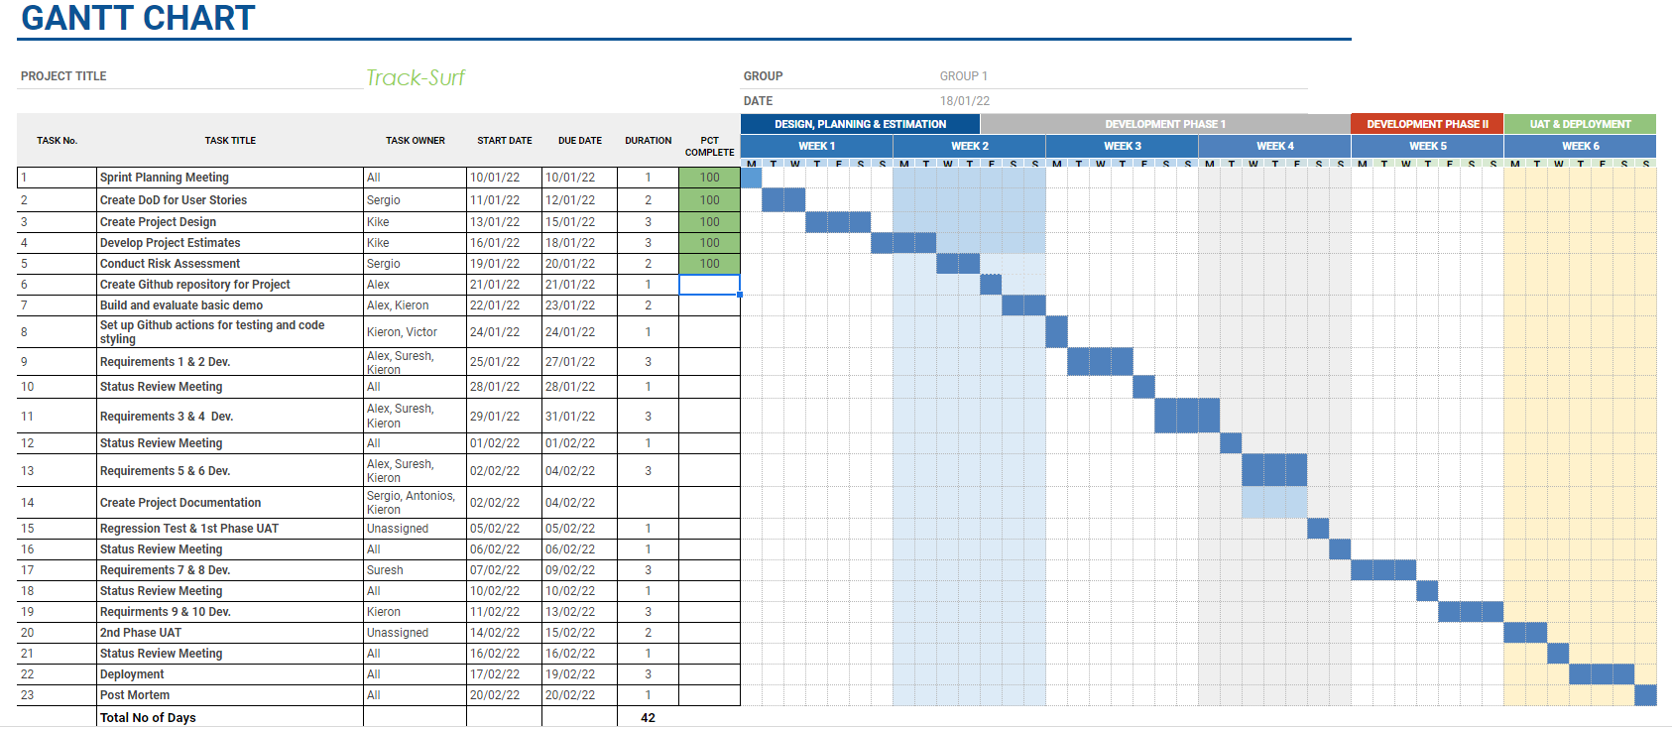
Planned Schedule
Fig 3: Gantt Chart

Slide 8
Milestones
Kick-off
Current
state
UAT sign-off
Design Planning
Estimation
start
10 Nov
17 Nov
10 Jan
14 Jan
15 Feb
21 Mar
4 Apr
Requirement Gathering
start
Development Phase I
start
Development Phase II
start
Go live
Fig 2: Project Milestones
Notes:
In this slide we can see a high-level overview of key milestones, keeping in mind good practices and aligned objectives between stakeholders and the project team.
The goal is to have a successful project, delivered on time and with the approval of every party involved.
As you can see, the requirement gathering process started on the 17th of November. This step has been reviewed carefully because it represents the backbone of the whole project.
On the 10th of January, we began what we called the “design, planning and estimation” phase. At this moment, we had a complete picture of what the stakeholders wanted and how we would proceed with the resources and experience that our team is capable of delivering.
The development process has been divided into two phases to perform regression tests before the end of each one. It also focuses on delivering the top priority requirements in the first phase. This phase was scheduled to start on the 21st of January and it has been completed.
On the slide, you can see our current state. We are planning to start the second development phase, projected to be ready by the 21st of March, where we have scheduled to perform the User Acceptance Testing Sign-off.
Finally, the project is scheduled to go live by the 4th of April.

Slide 9
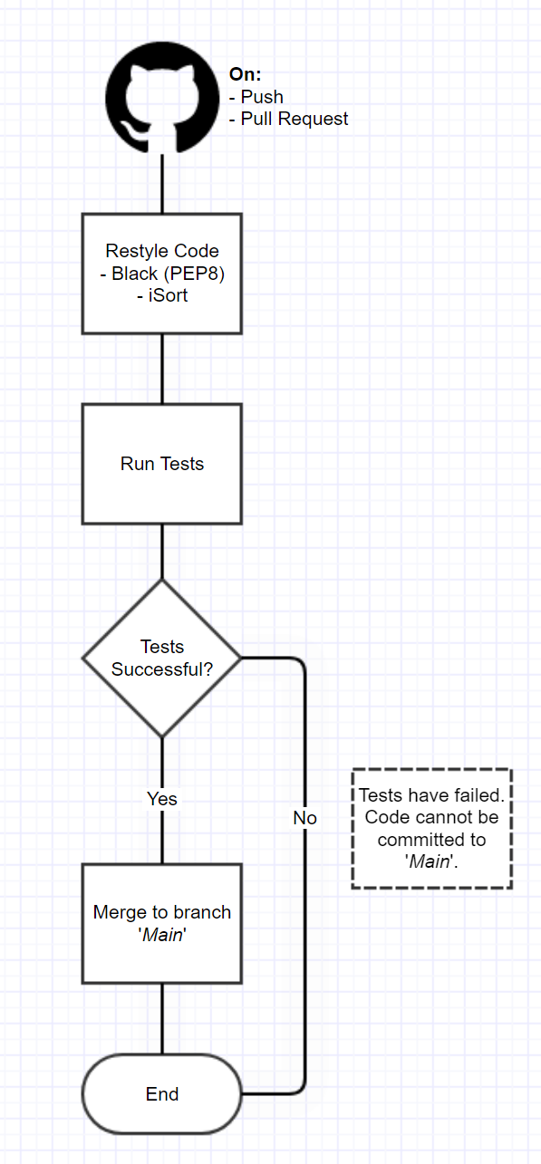
Quality Control
In order to ensure all project code is fully tested and of a standard format, we have chosen to use a series of Github Actions (A free automation tool provided by our chosen version control platform).
Benefits of this approach:
No single point of failure (A single developer is unable to push untested code to version control).
All code is automatically subjected to style checking, ensuring that all code is compliant and can be understood by other developers.
Fig 3: Code Quality Workflow

Slide 10
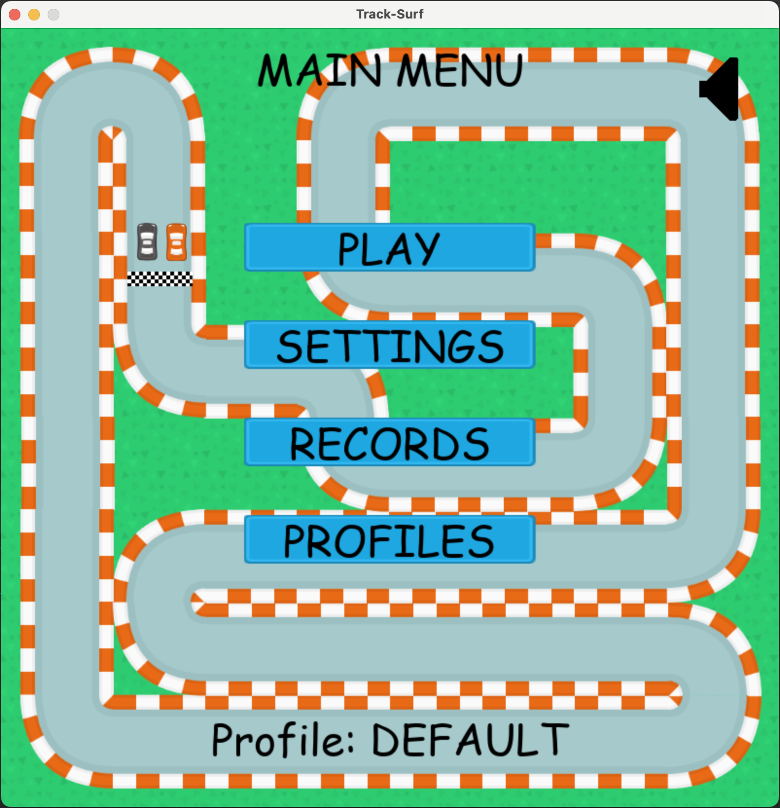
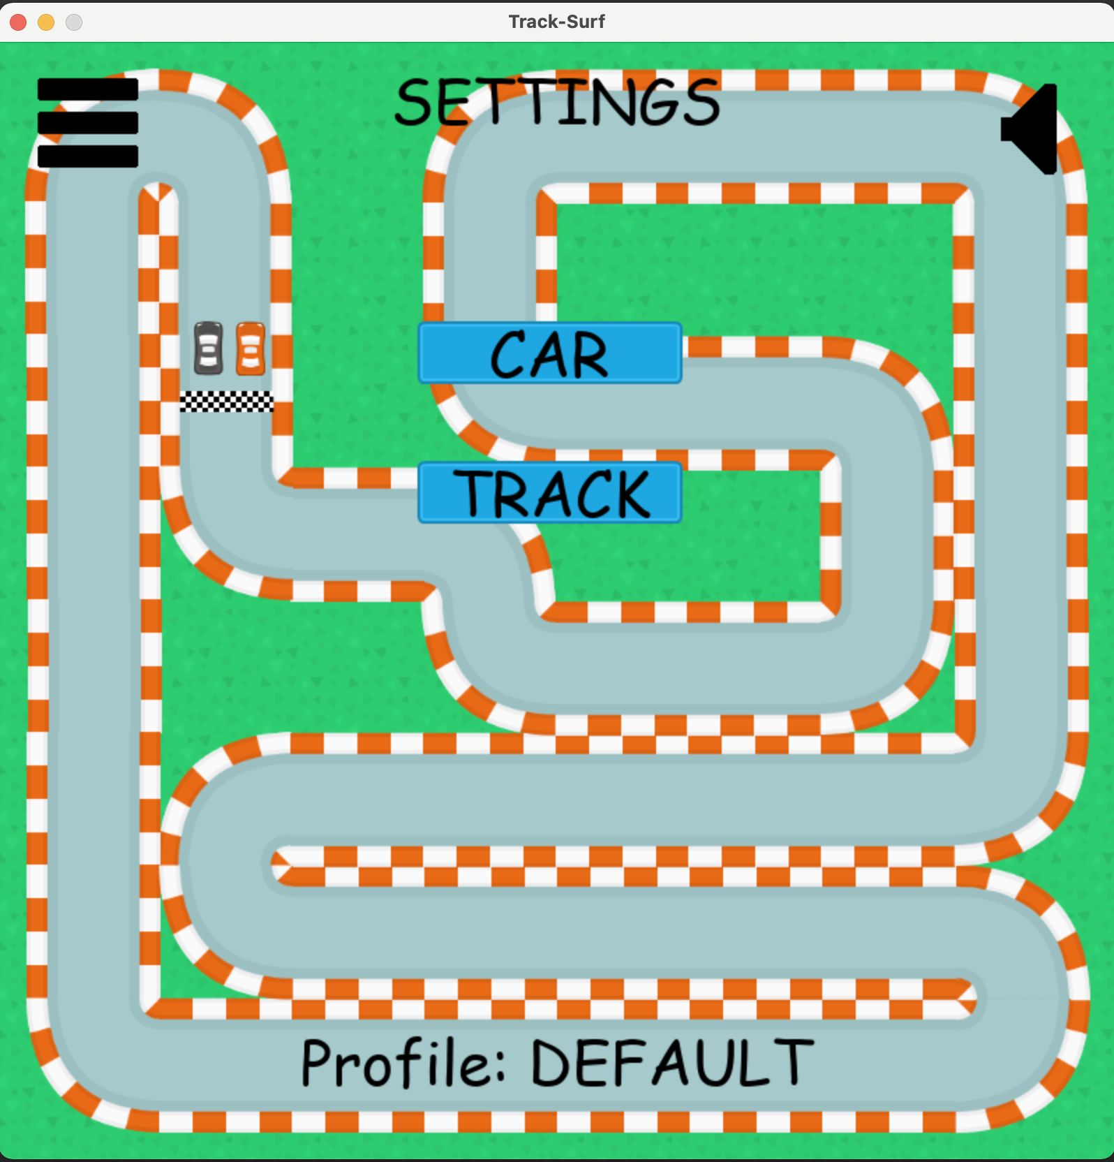
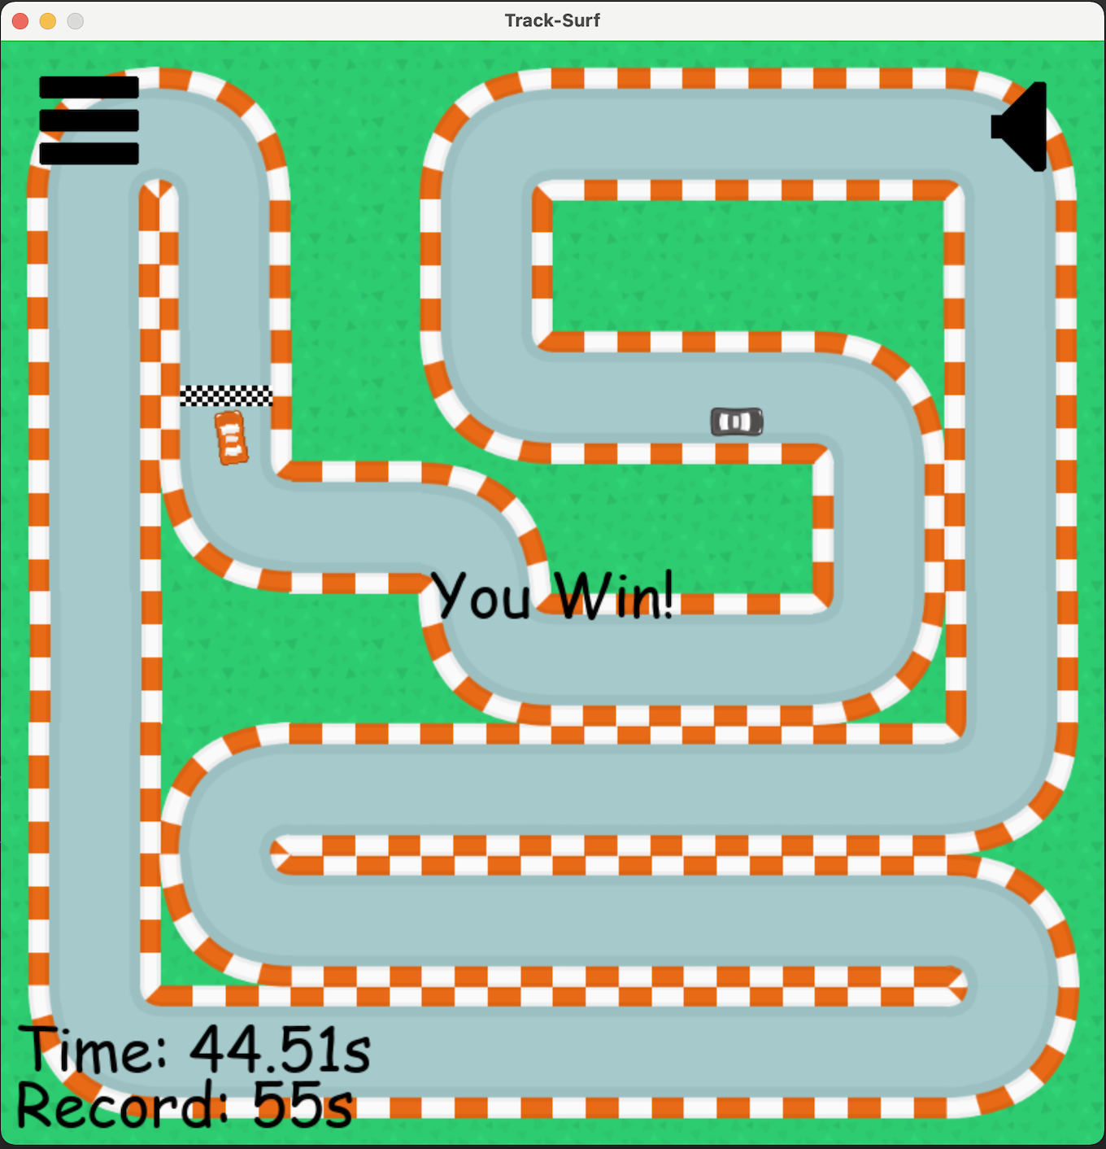
Project Simulation
Main Menu
Settings
Gameplay

Slide 11
Summarizing
Development
Quality increase
Communication
User’s feedback

Slide 12
Thank you
SEPM Project Car Racing Game: Track-Surf
By
Group 1
(Alex George Lain, Antonios Kalaitzakis, Kieron Holmes, Kikelomo Obayemi, Sergio Zavarce, Suresh Melvin Sigera, Victor Hernandez)

Slide 13
References
Berlin, S., Raz, T., Glezer, C. and Zviran, M. (2009). Comparison of estimation methods of cost and duration in IT projects. Information and software technology, 51(4):738-748.
Calefato, F. and Lanubile, F. (2011). A planning poker tool for supporting collaborative estimation in distributed agile development. In Proc. 6th Int. Conf. Softw. Eng. Adv.(ICSEA):14-19
Douglas, D.E., 1978. PERT and simulation. Institute of Electrical and Electronics Engineers (IEEE).
Eriksson, H.E. and Penker, M. (2000). Business modeling with UML. New York, 12.
Grimstad, S., Jørgensen, M. and Moløkken-Østvold, K. (2006). Software effort estimation terminology: The tower of Babel. Information and Software Technology, 48(4):302-310.
McLeod, L. and MacDonell, S.G. (2011). Factors that affect software systems development project outcomes: A survey of research. ACM Computing Surveys (CSUR), 43(4):1-56.
Royer, P.S., 2000. Risk management: The undiscovered dimension of project management. Project Management Journal, 31(1), pp.6-13.
Siva Karthik Reddy, L., Koka, K., Dash, A.K. and Pandey, M. (2019) Elemental Racing. In Emerging Research in Computing, Information, Communication and Applications. 29-43. Springer, Singapore.

